Slide 1

STA-9750 – Final Project
Analyzing 311 Service Delivery Across NYC's Income Divide
Team Members:
Kyle Shaddox
Reem Hussein
Hyacinthe Sarr
Juan Jaimes
Shahria Ahmed

Slide 2
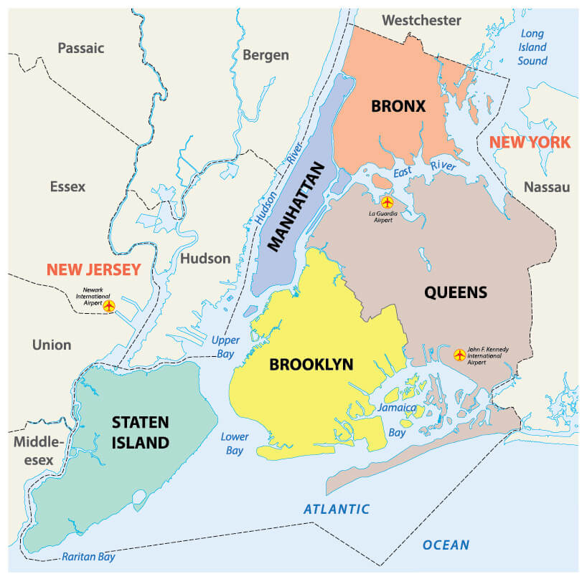
Does NYC provide faster and more effective 311 service responses to wealthier neighborhoods compared to lower-income communities?
What is 311?
NYC 311 acts as a centralized hub for residents to access non-emergency city services and information (i.e. things that don’t require calling 911)
It is available via phone, text, mobile app, and online through the NYC 311 website
311 Covers essential services such as
  Potholes, broken sidewalks, missing/damaged street signs, broken street signals
  Housing & public health problems such as heat or hot water, building violations, air quality issues
  Public disturbance such as noise complaints, illegal parking
What Geographical Areas?
Manhattan
Queens
Brooklyn
Bronx
Staten Island

Slide 3
Anticipated Challenges
Data Integration/Tables
Data set may be too large and we need to focus on a smaller window of time
Census data is as of 2020 and demographics changed post covid. We would need to find an appropriate timeframe or estimate current demographics
Data quality is unknown and joining data may be a challenge
Aligning 311 records with neighborhood income data
Some complaints may remain open for years, skewing averages; need trimming or median-based measures.
Statistical Methods
Regression model and analysis may be successful only in a specific time frame. How it will perform over a different timeframe may be unknown
Validation
There may not be any meaningful pattern in the data or a satisfying conclusion

Slide 4
Mid Semester Updates
We have two main datasets:
  311 complaints
  311 complaints resolutions and satisfaction
Both are massive amounts of data (3+ million rows), so we decided to narrow our scope
New timeframe is first four months of 2024
The RSocrata package was deprecated earlier this year, so we ran into some issues initially but managed to resolve them
We are dropping one of our questions (seasonal and yearly analysis) due to large data constraints. May look into a YoY analysis on the same 4 months
This reduction of the timeframe may affect the regression analysis, because it is only based on 4 months
NYC property valuation dataset is roughly ~9 million rows, API does not allow us to pull large amounts of data so we need to break it down to smaller chunks and limit to 1 million rows.

Slide 5
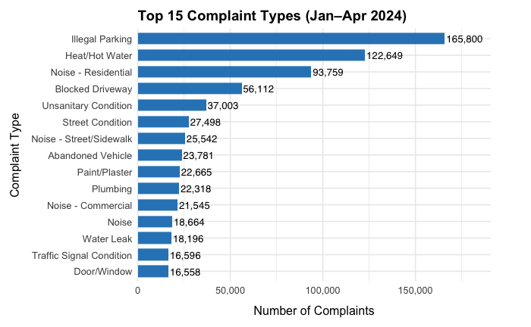
Exploratory Analysis – 311 data set

Slide 6
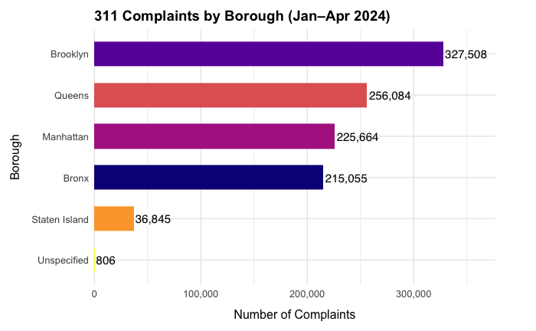
Exploratory Analysis – 311 data set

Slide 7
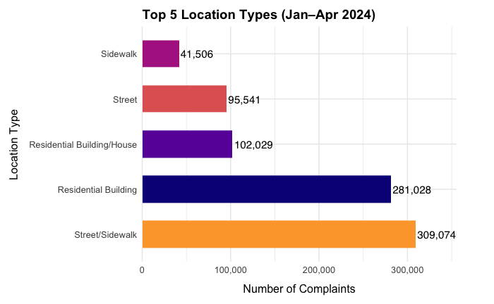
Exploratory Analysis – 311 data set

Slide 8
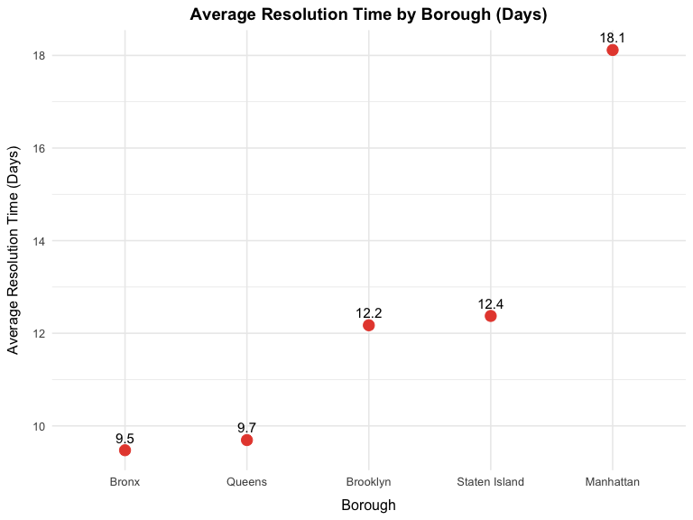
Exploratory Analysis – 311 data set

Slide 9
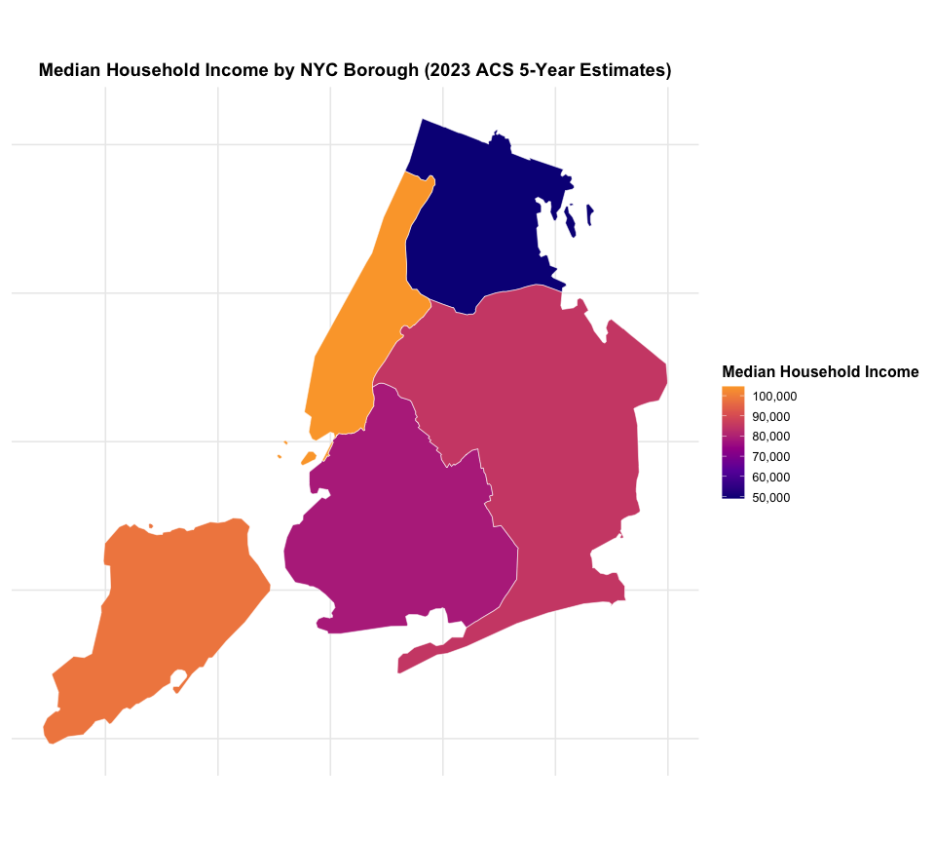
Exploratory Analysis – Census

Slide 10
Core Analytical Questions
REEM Question One - What is the average response time to quality-of-life complaints by neighborhood?
  This helps reveal which areas of the city receive faster attention from 311 and where delays are most common
REEM Question Two - How does median household income vary across the neighborhoods in our dataset?
  Understanding income variation provides important context for analyzing differences in service delivery and access
SARR Question Three - Is there a relationship between income levels and average 311 response times?
  Exploring this connection can uncover patterns of inequity and help determine if resources are distributed fairly

Slide 11
Core Analytical Questions
Juan Question Four - Do certain types of quality-of-life complaints (e.g., noise vs. sanitation vs. illegal parking) get resolved faster in wealthier neighborhoods?
  Looking at this sheds light on whether some issues are prioritized differently depending on a community’s wealth
Kyle Question Five - Which boroughs or neighborhoods show the greatest disparities in 311 response times when compared by wealth?
  This comparison highlights where service gaps are most significant and where targeted improvements may be needed
Shah Question Six- Can we predict where a complaint came from (neighborhood) based on the complaint?
  This can help us determine how long it will take for the complaint to be resolved

Slide 12
Data Sources
Three data sources we will use
US Census
  https://www.census.gov/programs-surveys/acs
City of New York
  https://data.cityofnewyork.us/City-Government/311-Resolution-Satisfaction-Survey/5ijn-vbdv
  https://data.cityofnewyork.us/Social-Services/311-Service-Requests-from-2010-to-Present/erm2-nwe9/about_data
  https://catalog.data.gov/dataset/property-valuation-and-assessment-data-db7c2
City of New York – Population Fact Finder
  https://popfactfinder.planning.nyc.gov
Other – To be determined

Slide 13
Next Steps...
Further exploratory analysis, specifically Census and property valuation for NYC
Answer individual questions and overarching question
Conduct correlation and regression analysis to test relationships.
Prepare final report and visuals for end-of-semester presentation
END

